Slide 1
SIGN Dementia Guideline: Implications for Research
Dr Adam Daly
Guideline Development Group Chair

Slide 2
The Need for this guideline
Variations in practice across Scotland includes:
Services and pathways for people with young onset dementia
Treatment of cognitive and non-cognitive symptoms in dementia
Psychological approaches
Management of stress and distress
Notes:
There was no clear guidance for Scotland (or elsewhere)
A wealth of new evidence
Professionals and service user voices

Slide 3
Aim of the guideline
Aims
to provide evidence based recommendations on
Assessment
Diagnosis
care and support for people with dementia and their carers
to inform and provide benefit to all stakeholders, ensuring
timely, person-centred interventions and
efficient utilisation of resources
Notes:
There was no clear guidance for Scotland (or elsewhere)
A wealth of new evidence
Professionals and service user voices

Slide 4
Progress and Strategic Driver Since 2006
Dementia Strategy (2010 – 2012)
Dementia Strategy (2013-2016)
Dementia Strategy (2017 – 2020)
Achieving Excellence
Standards of Care for Dementia in Scotland
Post Diagnostic support HEAT target
5 Pillars
8 Pillars
Advanced Care
And much, much more
Charter of Rights
Notes:
This page could have been very large
These are a selection of the drivers

Slide 5
Developing the guideline

Slide 6
Proposal form
16 Headings including:
2. Burden of the condition
3. Variations
6. Aspects of the proposed clinical topic that are key areas of concern for patients, carers and/or the organisations that represent them
11. Relevance to current Scottish Government policies
12. Who is this guidance for?
Notes:
What is the problem/need for a guideline/clinical scenario?
Burden of the condition
Variations
In practice in Scotland
In outcomes on Scotland
Areas of uncertainty to be covered
KQ1 – What aspects of assessment and diagnosis can be standardised?
KQ2 – Evidence base for Pharma and non-pharma treatment for cognitive and non cognitive symptoms?
5. Areas that will not be covered
Head injury
6. Aspects of the proposed clinical topic that are key areas of concern for patients, carers and/or the organisations that represent them
7. Population
8. Healthcare Setting
. Potential
To improve practice
Reduce variation
Potential impact on important health outcomes
Diagnosis Rates
Quality of Life Indicators
Functioning indicators e.g. Activities of Daily Living
Potential impact on resources
Acute hospital admission rates for people with dementia
Prescription of antipsychotic and anxiolytic medications
Length of post diagnostic engagement
10. What evidence based guidance is currently available?
None
SIGN 86 – out of date
NICE CG42 – out of date
11. Relevance to current Scottish Government policies
12. Who is this guidance for?
13. Implementation
14. Primary Contact for proposal
15. Group(s) or institution(s) supporting the proposal
16. Large Declaration of Interest (DOI) section

Slide 7
Next steps
Submission to SIGN Council
Presentation at SIGN Council
Tweaks and further discussion
Commissioning
SIGN choose a chair
Institution stakeholders identified/open invite
Group members identified and confirmed
1st meeting convened (Feb 2020)

Slide 8
Challenges
Limited resources
Staff pressures
NICE 97

Slide 9
Development overview and timescales
Key questions and paper selection
[group]
Critical appraisal
(Aug – Dec 21)
[SIGN exec]
Further searches, selection & appraisal
(Jan 22)
[group & SIGN exec]
Considered judgement
(Jan – Aug 22)
[group]
First draft
(Sep-Oct 22)
[group]

Slide 10
Development overview and timescales
National meeting and Peer review
(Oct 22 – Jan 23)
[SIGN exec]
Consultation edits
(Feb – Apr 23)
[group]
Editorial group
(May – Jun 23)
[SIGN exec]
DTP & sign off
(Jul 23)
[SIGN exec]
Publish
(Nov 23)
[SIGN exec]

Slide 11
Involving people with lived experience
With thanks to Karen Graham, Patient Involvement Advisor, SIGN

Slide 12
Engagement with third sector organisations
Alzheimer’s Scotland
Alzheimer Scotland’s National Dementia Carers Action Network
Carers Scotland
Carers Trust Scotland, Carer Voices (The Alliance)
tide
Age Scotland
About Dementia
Life Changes Trust
Scottish Dementia Working Group
Alzheimer’s Society
Young Dementia UK
MECOPP
LGBT Health and Wellbeing
Scottish older people’s assembly

Slide 13
Key issues highlighted from submissions
Support and training for carers
Education for healthcare professionals
Communication with people with dementia and their families
Who should communicate diagnosis of dementia
Post-diagnostic support for person and carers
Information needs throughout care
Equal partnerships and involvement of person with dementia
Transition between settings and support

Slide 14
Representation on guideline group
1 representative from third sector organisation
2 carer representatives

Slide 15
Direct engagement with people with dementia
Meeting with Scottish Dementia Working Group members to discuss what matters most to people (5 members)
Meeting with About Dementia, Age Scotland members to discuss draft section of ‘Provision of information’ to get their views (6 members)
Organised a consultation meeting “pre meet” to support people to participate in consultation meeting (20 people attended)
Ran workshop specifically for people with dementia and carers to get feedback on guideline
Invited individuals with dementia to peer review guideline (1 person participated)

Slide 16
Open meeting and comments
Draft document published for comments
Open meeting
Thursday 27 October 2022
Online
200 attendees
Every Health Board area

Slide 17
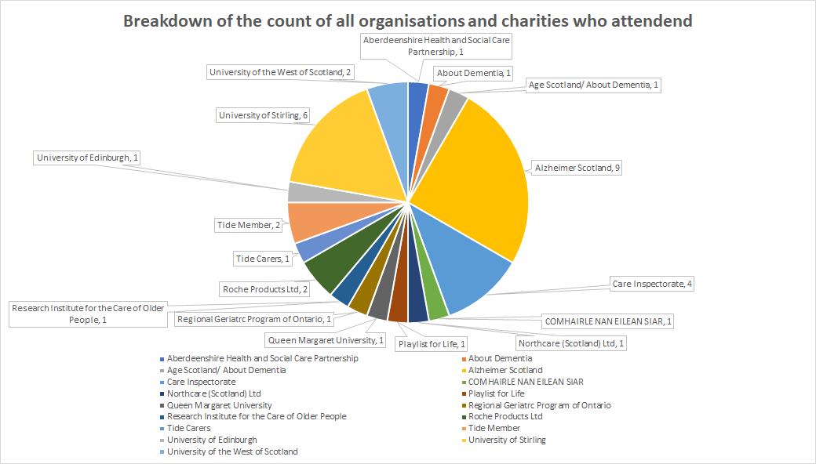

Slide 18
Person-centred guidance
Issues from third sector organisations reflected in KQs
KQs changed/added to reflect concerns of carers on guideline group
Provision of information section changed to include issues of importance to people with dementia and carers
Infographic in guideline on post-diagnostic support changed to reflect views of people with dementia

Slide 19
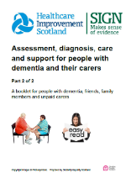
Involving people with dementia and carers in development of plain language version
Meeting with people with dementia and carers to discuss preferences for plain language version of guideline (13 participants)
Pre-consultation meeting (15 participants)
Consultation (11 participants)

Slide 20
Patient Version of Guideline

Slide 21
The guideline
Note: 116 pages cannot be summarised well in 5 minutes!

Slide 22
The Sections
The start
1. Introduction
2. Key Recommendations
The Evidence and full recommendations
The end
9. Provision of Information
10. Implementing the Guideline
11. The Evidence Base
12. Development of the Guideline

Slide 23
Recommendations
121 points in total
67 Recommendations
6 Key recommendations
43 Good Practice Points
11 Information points
Notes:
Chapter
R
GPP
IP
Total
3 Identification and diagnosis of dementia
10
9
4
23
4 Further investigative procedures
3
6
9
5 Postdiagnostic support
21
9
2
32
6 Non-pharmacological approaches for distressed behaviours
5
4
9
7 Grief and dementia
12
5
17
8 Changing needs of people with dementia
16
10
5
31
Total
67
43
11
121
Chapter
R
GPP
IP
Total
3 Identification and diagnosis of dementia
10
9
4
23
4 Further investigative procedures
3
6
9
5 Postdiagnostic support
21
9
2
32
6 Non-pharmacological approaches for distressed behaviours
5
4
9
7 Grief and dementia
12
5
17
8 Changing needs of people with dementia
16
10
5
31
Total
67
43
11
121

Slide 24
Key recommendation 1:Identification and diagnosis of dementia
Healthcare professionals should ensure that the discussion of a diagnosis of dementia should include positive and hopeful, yet realistic, messages; information on prognosis and sources of support; information on wellbeing and how the person with dementia can continue with their life, maintain their sense of self and accept their identity as someone with dementia.
Notes:
Emphaisis on these lsides is my own – as

Slide 25
Key recommendation 2: Anticipatory (Future) care planning
Anticipatory care planning may involve a series of conversations over time, to allow clarification, reflection and updates to the plan to reflect any changing needs. Early discussions are beneficial, as the capacity of the person with dementia diminishes as the disease progresses.
Anticipatory Care Planning decisions should be reviewed and updated; the frequency of this will be influenced by the pace of disease progression and any changing needs

Slide 26
Key recommendation 3: Post diagnostic support
Postdiagnostic support should incorporate continuity of care, including a ‘one-stop’ service or single point of contact, a single professional or case manager. This should be a healthcare or social care professional with appropriate skills, knowledge and expertise in dementia (see the Promoting Excellence Framework), working with the GP, to ensure a tailored support package is delivered in a timely manner.

Slide 27
Key recommendation 4: Grief and dementia
Healthcare professionals should be aware that carers of people with dementia may experience pre-death grief from the point of diagnosis and throughout the stages of dementia, and sensitively enquire about these experiences:
worsening pre-death grief as dementia becomes more severe
worsening pre-death grief at transition points, such as when the person with dementia is moved to long-term care.

Slide 28
Key recommendation 5: Non-pharmacological approaches for distressed behaviours
For managing distressed behaviour symptoms in people with dementia, tailored activities based on a comprehensive structured assessment may be considered. Activities should be individualised, focus on preserved capabilities and consider previous roles, interests and preferences.
For carers of people with dementia, provision of tailored psychoeducation and skills training may be considered.

Slide 29
Key recommendation 5: Non-pharmacological approaches for distressed behaviours
Components may include:
problem solving
identifying triggers
coping strategies for distressed behaviour
stress reduction
cognitive restructuring
communication skills
crisis management.

Slide 30
Key recommendation 6: Changing needs of people with dementia
Changing needs of people with dementia
Healthcare professionals should be aware that existing measures to define end of life in people with dementia based on cognition and ambulatory function may be ineffective and may not recognise the unmet needs at end of life.
Healthcare professionals should focus on the needs of the individual and consider moving away from a focus on defining end of life by disease stage.

Slide 31
Research Recommendations

Slide 32
How the evidence we have shaped the guideline
50% Qualitative or Mixed Research Method
NICE 97

Slide 33
Limitations of the evidence base
Many areas with limited research
Even fewer areas with high quality studies
Study design issues
Very small studies
Methodological challenges (i.e. blinding)
Often novel interventions, never repeated
Few studies look at the views of people with dementia

Slide 34
Opportunities for further study: Overview
Every area had opportunities
More detail on pages 81 – 83
What follows is a selection of 30 recommendations

Slide 35
Opportunities for further study: Dementia diagnosis
Perceptions of people with dementia on timing and processes of dementia diagnosis discussions
The role of the MDT in dementia diagnosis
The impact of training in communication about disclosure and methods of communication on people with dementia and their carers.

Slide 36
Opportunities for further study: Brief screening tools
More research on telephone and video-based screening tools. These studies should assess accuracy, feasibility and acceptability in real-world populations
Research on the accuracy, feasibility and acceptability of new screening tests, such as Free-Cog and Oxford Cognitive Screen

Slide 37
Opportunities for further study: Remote assessment
The feasibility, acceptability and supportiveness of remote assessment in the diagnosis of dementia.

Slide 38
Opportunities for further study: Fluid Biomarkers
Evaluation of emerging tau PET tracers against alternatives
Long-term follow-up of people with different clinical diagnoses and positive or negative CSF biomarkers for Aβ42, T-tau, and P-tau, including eventual postmortem examination validation. In particular, more data is required on biomarkers’ diagnostic value in older people who are more likely to have Alzheimer’s disease copathology.

Slide 39
Opportunities for further study: Postdiagnostic support
Research into the experiences of postdiagnostic support in minority groups, those with protected characteristics, those with young-onset dementia and young carers
Postdiagnostic support specific to people with advanced dementia

Slide 40
Opportunities for further study: Distressed behaviours
Better evidence for non-pharmacological therapies and the effectiveness of such therapies for distressed behaviours
Research focussed on how carers communicate and interact with a person when they are distressed, including communication style, method and de-escalation

Slide 41
Opportunities for further study: Grief and Dementia
People with dementia’s experience of pre-death grief and bereavement and how to support them with managing this
How people with mild to moderate dementia experience grief and how to help them retain the pertinent information about their loss and process the loss

Slide 42
Opportunities for further study: Changing needs
Assessment of approaches to address changing or unmet needs in people with moderate, advanced or severe dementia
Regular assessment of newly developed comorbidities and cardiovascular risk factors, and the implications of holistic or integrated care assessment.

Slide 43
Opportunities for further study: Anticipatory care planning
ACP during the earlier stages of dementia.

Slide 44
Next steps

Slide 45
Implementation
Work on promotion
Right Decision Service
Close working with HIS
Dementia Strategy & Workplan

Slide 46
Questions and comments

